Slide 1
ESSENTIAL COMPONENTS OF JAVA

Slide 2
1.STAtic Members
A member is declared inside a class with a ‘static modifier’ is known as a class member or static member.
These are global members which are global to the class and its objects.
These members are bound with class name and are accessed without creating objects.
Memory for static variables is only allocated once and that is during loading of the class (helps in saving memory).
Even main method is declared static so that JVM can call this without creating an instance of the class.
A static block is used to initialize the static data member . It is executed before main method at the time of class loading.

Slide 3
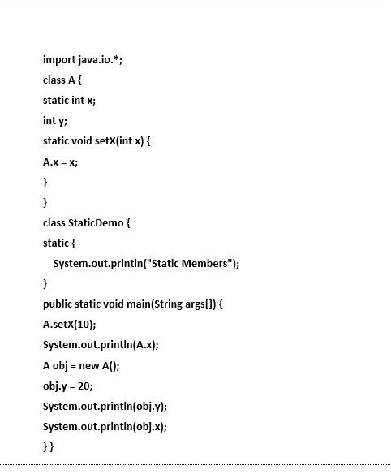
Let’s a take a simple example:
OUTPUT
Static Members
10
20
10

Slide 4
2.Final
A variable declared as final can’t be modified. It can be used as a constant.
Example : final float PI = 3.14;
Final keyword can be used to prevent method overriding . Final methods are usually inlined by the java compiler.
Final keyword can be used to prevent a class from being inherited . This will implicitly declare all methods in the class as final too.
EXAMPLE class A { final void meth() { System.out.println(“Final Method”); } class B extends A { void meth() { System.out.println(“ERROR!”); //Error } }
EXAMPLE final class A { void meth() { System.out.println(“Final Method”); } class B extends A { //Error ! void sample() { System.out.println(“ERROR!”); } }

Slide 5
3.INNER CLASS
Java inner class or nested class is a class i.e. declared inside the class or interface.
We use inner classes to logically group classes and interfaces in one place so that it can be more readable and maintainable.
Inner class can access all the members of outer class including private data members and methods.
4.JFRAME
Java Swing is a part of Java Foundation Classes (JFC) that is used to create window-based applications. It is built on the top of AWT (Abstract Windowing Toolkit) and entirely written in java.
All swing components are represented by classes defined within javax.swing package .
Jframe is a top level container that is used for swing applications .
It’s a window with title, border, (optional) menu bar and user-specified components.
It can be moved, resized, iconified.

Slide 6
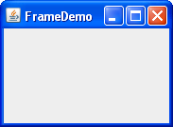
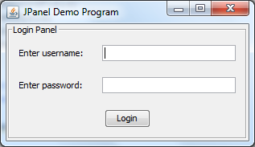
Example : JFrame frm = new JFrame(“FrameDemo”);
5. JPANEL
JPanel is a Swing’s lightweight container which is used to group a set of components together.
Example : JPanel jp = new JPanel(); // This will create a new JPanel
We can set the layout of the panel , add components to the panel , customize the panel’s appearance with the help of built in functions and classes.
6.JBUTTON
The JButton class provides the functionality of a push button.
Jbutton allows icon , string , or both to be associated with a push
button.
The constructors of JButton are : 1. JButton(Icon icon) 2. JButton(String str)

Slide 7
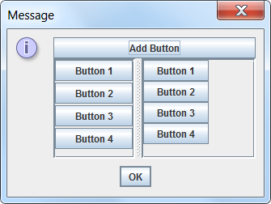
3. JButton(String str,Icon icon)
JButton is derived from JComponent class(which contains all swing components).
There are several types of buttons in swings
Command buttons
Toggle buttons
Check boxes
Radio buttons
7.IMAGEICON
We have included an icon in JButton class as show earlier. Java provides a default imageicon.
Instead of using default icon , we can use our own icon using ImageIcon class.
ImageIcon implements Icon and encapsulates the image.

Slide 8
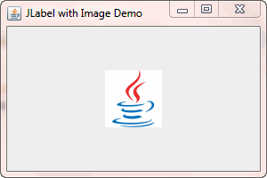
The constructor of ImageIcon class is : ImageIcon(String filename)
Example : ImageIcon icon = new ImageIcon("images\\java.gif");
The other essential components of swings include :
Menu Bar
Text area
Password field
Separator
Progress Bar
Scroll Bar

